Slide 1
Plant Disease Detection
N. Shalini : 2451-16-737-002
A. Jyothi : 2451-16-737-008
K. Vinay : 2451-16-737-009
Guide : K. Devaki mam

Slide 2
Abstract
Agricultural productivity is something on which economy highly depends.
The plant leaf diseases have been effecting the productivity, quality and efficiency of the plants. To overcome this, the plant leaf diseases are to be recognised during the initial stages.
The proposed project is based on the Image processing technique using Matlab, where the pictures of the leaves are given as the input to the system.
The images are used to train the data sets and support vector machines, and correspondingly the diseases are identified based on the trained dataset.

Slide 3
Introduction a. Problem Statement
One of the most important sector of the economy is agriculture.
Farmer’s economic growth relies on the quantity of the products they produce, which depends on the plants growth and yield they get.
Plants are highly prone to diseases which in turn reduces the yield of the crop. Thus, Detection of the plant diseases plays an important role in farming. But manual detection is a tedious job.
Hence, Automatic detection of plant diseases is essential as it may prove benefits in monitoring large fields of crops, and thus detect the symptoms of diseases as soon as they appear on plant leaves.

Slide 4
b. Requirement Specification
Hardware specification:
Windows-64 bit , Intel core processor
Software specification :
Matlab: R 2014 a

Slide 5
Literature Survey
The different classification techniques used for plant leaf disease classification were proposed by using some classification techniques like k-Nearest Neighbour Classifier, Probabilistic Neural Network, Genetic Algorithm and Principal Component Analysis, Artificial neural network, Fuzzy logic.
But, the accuracy of most of the results were below 90% only. Experimental results showed the classification action by ANN taking feature set is better with an precision of 91%.
The proposed system is to detect the plant leaf disease at early stage with 96% accuracy by using Support Vector Machines.

Slide 6
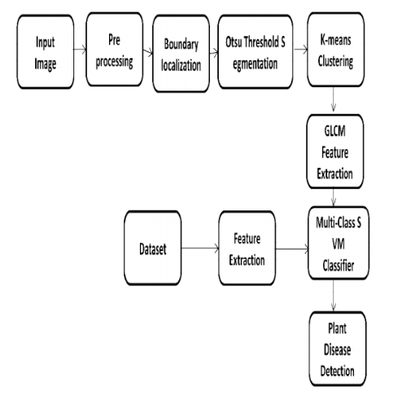
Flow Chart

Slide 7
OVERVIEW
The input image was pre-processed by converting the image to black and white image.
The second stage is the segmentation, which uses the OTSU Segmentation to contrast and enhance the pre-processed image.
The third step is the K-Means Clustering to cluster the image according to the contrast colour.
Fourth step is the feature extraction, which uses GLCM feature extraction for extracting the clustered images.
Fifth phase is the classification of images using Multi-Class SVM from the extracted images. Finally, the five phases also done for datasets.
The comparison was done for result set and data set, after all the disease name, accuracy and affected percentages was calculated.

Slide 8
Implementation
Step 1: Pre-Processing :
The input image was resized to 256 X 256.
A coloured image was enhanced to the contrast colour.
The input image was marked with red colour in the boundary, veins and affected part of the leaf.
Step 2: OTSU Segmentation:
Thresholding (A simplest form of Image segmentation) is done using Otsu’s method which converts the intensity image to binary image. We Convert the RGB image format to a grey-scale image.

Slide 9
Level = graythresh(I) computes a global threshold (level) that can be used to convert an color image to a binary image with “im2bw.” A level is a normalized intensity value that lies in the range [0, 1].
The graythresh() uses the Otsu's segmentation method, which selects the threshold value to minimize the intra class variance of the black and white pixels.
[level EM] = graythresh(I) gives the effectiveness metric, EM, as the second output argument. The EM is a value in the range [0 1] that indicates the effectiveness of the threshold value of the input image.
Here, each pixel is replaced with a black pixel if the pixel threshold is less than constant., and with white if it is greater than constant.

Slide 11
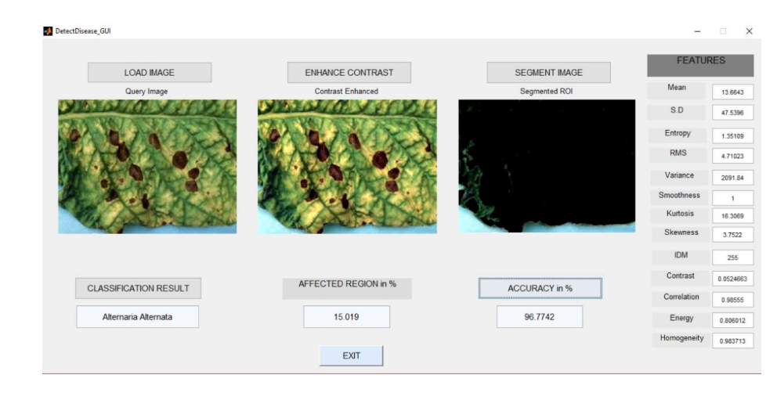
outputs

Slide 12
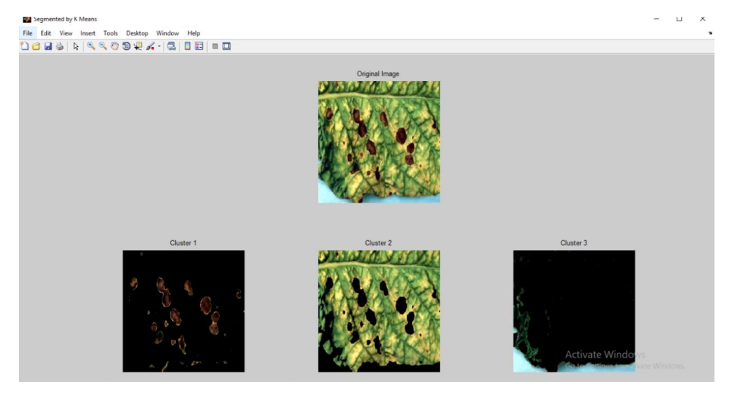

Slide 13
CONCLUSION
This project gives the executed results on four kinds of diseases.
SVM classification technique has proved to give the most effective results for plant leaf disease detection and an algorithm for image segmentation technique used for Automatic detection as well as classification of plant leaf diseases has been clearly demonstrated.
From these methods, we can accurately identify and classify various plant diseases using image processing techniques.

Slide 14
Scope of work
The performance of the system can be improved in the future by using advanced background separation methods to separate the leaf object from a complex background.
More infections like downy mildew (DM) and sudden death syndrome (SDS) can also be classified.
But due to non-availability of suitable and sufficient training and test data at present, it has not been incorporated into the present work.
The similar methodology can be applied to other plant infections and early warning systems for rice, cotton-crops, fruits, vegetables and beans, etc.

Slide 15
References
www.google.com
Mrunalini R Badnakhe,DeshmukhPrashant R.An application. Of K- means clustering and artificial in pattern recognition for crop disease .Int Find Adv INF Technology 2011;20.2011 IPCSIT.
http://www.journal4research.org/articles/J4RV2I2033.pdf
http://www.ijircce.com/

